Slide 1
Personal assistant
“Guidance for every step of the way”

Slide 2
Lets get started !

Slide 3
What is My PA?
Personal Assistant is a smart application, offering personalized guidance for every step of the way.
From restaurant recommendations based on favorite cuisines just for you, to Weather report and latest news based on your preferences.
My-personal-Assistant has news sources from all across the world, so it’s likely you’ll be able to find your favorite sites and publications.
The app can set up a daily briefing to give you the most important stories of the day

Slide 4
User activity
Welcome Page
Setup New Profile
No
Profile exist ?
Yes
Access Existing profile
Complete New Profile request
Select
Profile
Submit New Profile request
Display News Feed based on user preferences
Display time based greeting current temp based on user location
Display recommended restaurants based on user preferences and location

Slide 5







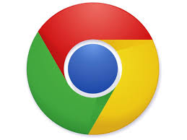





List of Technologies use

Slide 6
Future VISION of MY PA
Authentication of user accounts
Google directions for restaurants
Update user profile
Stock Ticker
Future weather forecast
Weather on demand

Slide 7
QUESTIONS?

